Slide 1

TITLE OF PROJECT
Submitted to:
Mrs. Rashika Singh
Submitted By:
Yashi Sharma 21CSEAIML34
Kunal 21CSEAIML17
Naman Bharadwaj 21CSEAIML20

Slide 2
INTRODUCTION
A language translator is a sophisticated software application that empowers individuals, businesses, and organizations to translate text, speech, or other forms of communication from one language to another. Leveraging advanced linguistic algorithms and artificial intelligence, these translators have evolved from simple word-for-word substitutions to dynamic systems that consider context, syntax, cultural nuances, and even idiomatic expressions. where language translators emerge as indispensable tools, serving as bridges that span linguistic chasms and enabling effective cross-cultural communication.

Slide 3
OBJECTIVES OF PROJECT
The objectives of a language translator are centred around enabling effective communication and understanding between individuals, groups, and entities that speak different languages. These objectives encompass a wide range of goals, from accurate translation of text to facilitating seamless cross-cultural interactions. Here are the key objectives of a language translator:
Accurate Translation
Preserve Context
Cultural Sensitivity
Ease of Use
Multimodal Translation

Slide 4
TECHNOLOGIES USED
This project is developed using the different technologies, which are used for development of the software. These technologies are follows:
Python language
Web development
Tesseract Open Source OCR Engine

Slide 5
ABOUT THE TECHNOLOGIES
This project is developed using the tools, which are used for development of the software. These tools are follows:
Python language: Python is a popular high-level programming language that is used for a variety of purposes, including web development with popular frameworks like Django and Flask, which are used in this project development as back-end development.
Web development: HTML, CSS, and JavaScript form the backbone of modern web development. They are used to make user-interface responsive, interactive, and visually appealing.
Tesseract: This package contains an OCR engine - libtesseract and a command line program - tesseract. Tesseract has unicode (UTF-8) support, and can recognize more than 100 languages "out of the box".Tesseract supports various image formats including PNG, JPEG and TIFF.

Slide 6
HARDWARE REQUIREMENTS
OS: Window 10 64-bit
CPU: Intel core i5-8400
Memory: 4GB or 8GB Ram (minimum)
Free storage: 5GB SSD

Slide 7
SOFTWARE REQUIREMENTS
To Handel the system, Administrator requires some software. This software is used for the development such as coding and testing. Lists are given below:
Front End- HTML, CSS, JS
Back End- Python, Tesseract
Server
Design Tool- Bootstrap
Documentation Tools

Slide 8
APPLICATIONS OF PROJECT
Language translators have a wide range of applications across various industries and use cases. Here are some common applications of language translators:
1. Travel and Tourism: Language translators are indispensable for travelers who need to communicate with locals in a foreign country. They help tourists read signs, menus, and understand basic phrases.
2. Business and International Trade: Companies engaged in international business use language translators to overcome language barriers when negotiating deals, drafting contracts, or communicating with foreign clients and partners.
3. Content Localization: Content creators, such as websites, apps, and marketing materials, use translation services to adapt their content to different languages and cultures, making it more accessible to a global audience.

Slide 9
SCOPE OF PROJECT
1. Improved Translation Quality: Advancements in neural machine translation (NMT) and AI techniques are expected for more accurate and contextually relevant translations will reduce misunderstandings and communication barriers.
2. Multimodal Translation: Language translators are expanding beyond text and speech to include other modes of communication such as images and gestures. This will enable more comprehensive and intuitive translation experiences.
3. Real-time Communication: Real-time translation during conversations, whether spoken or text-based, will become more seamless and natural. This will facilitate instant communication between individuals who speak different languages.

Slide 10
LIMITATIONS
The language translator currently supports a limited set of languages, restricting the variety of translation options available to users.
Processing Capacity: Due to server limitations, the application might experience reduced responsiveness during peak usage hours, affecting the overall user experience.
Data Privacy: While efforts have been made to secure user data, the application processes text, potentially containing sensitive information. Although encrypted, there is an inherent privacy concern that users need to be aware of.
External Services: The application relies on external translation APIs, raising concerns about data security and privacy policies of these third-party services.

Slide 11
DESIGN AND IMPLEMENTATION(ER DIAGRAM)
Frontend:
It is designed using HTML, CSS, and JavaScript.
Here the HTML file provides the structure for the web page. It includes elements such as a text area for input, a translate button, and a container to display the translated output. The CSS file ensures a visually appealing layout and user experience. The JavaScript file handles user input, triggers translation requests, and displays the translated output dynamically on the web page.
Backend (Python using Flask framework):
The backend of the web application is responsible for processing translation requests and returning the translated text to the frontend.
The Python file is developed using the Flask framework. It includes routes and logic to handle incoming translation requests. Upon receiving a request, it processes the input text, performs the translation using appropriate libraries or APIs, and sends back the translated text as a response to the frontend.

Slide 12
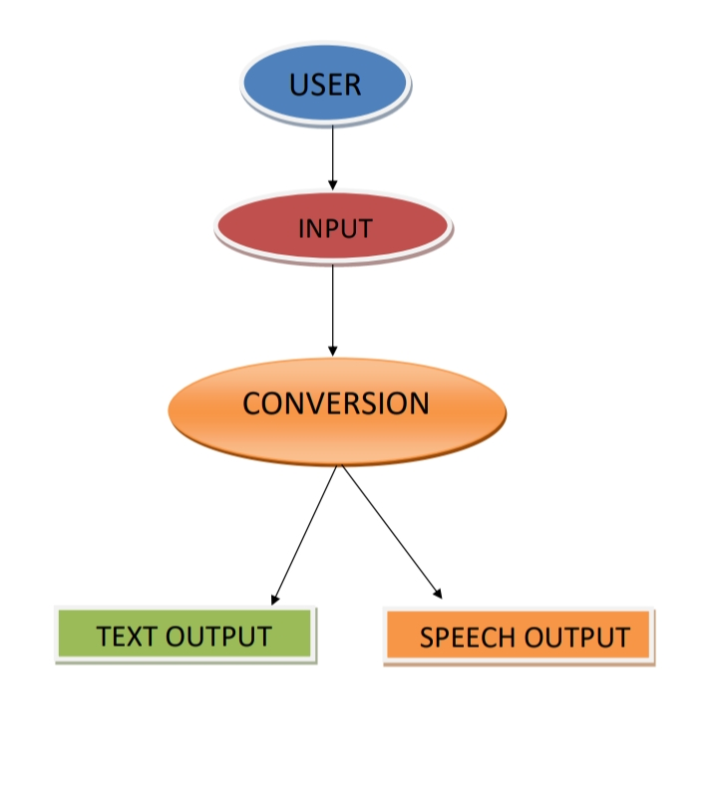
Data Flow Diagram

Slide 13
PROJECT MODULES
(MODULES DESCRIPTION)
Tesseract- Tesseract is an open-source Optical Character Recognition (OCR) engine developed by Google. It is designed to recognize text within images and convert it into machine-readable text. It's widely used for automating data extraction tasks, document digitization, and text recognition applications.
Python frameworks and libraries :
Flask- It is a web framework to handle HTTP requests, routes, and responses. Flask is lightweight and easy to use.
Googletrans- This library allows developers to translate text and detect languages programmatically.
PyPDF2- It is a Python library for reading and manipulating PDF files. It simplifies working with PDF documents, making it easier to automate tasks related to PDF file handling in Python applications.

Slide 14
CONCLUSION
(SPECIFYING PROJECT PROGRESS PERCENTAGE)
In conclusion, the development of the Language Translator Web Application has been a significant endeavour, aiming to provide users with a seamless and efficient platform for translating text, documents, and speech. Throughout the project lifecycle, various milestones were achieved, contributing to the overall progress of the application.
As of the completion of this report, the Language Translator Web Application stands at [40%] completion. This percentage reflects the overall progress made in terms of implementing the planned features, resolving technical issues, and ensuring the application's functionality and usability. The achievements made so far lay a strong foundation for the project's future development and refinement.

Slide 15
REFERENCES
https://www.python.org/doc/
https://flask.palletsprojects.com/en/3.0.x/
https://github.com/tesseract-ocr/tesseract
Google Cloud Translation API:
[https://cloud.google.com/translate]
(https://cloud.google.com/translate)
Microsoft Azure Translator:
[https://azure.microsoft.com/en-us/services/cognitive-services/translator/]
(https://azure.microsoft.com/en-us/services/cognitive-services/translator/)
Jay Alammar's "The Illustrated Transformer":
[http://jalammar.github.io/illustrated-transformer/]
(http://jalammar.github.io/illustrated-transformer/)

Slide 16
THANK YOU

